Slide 1


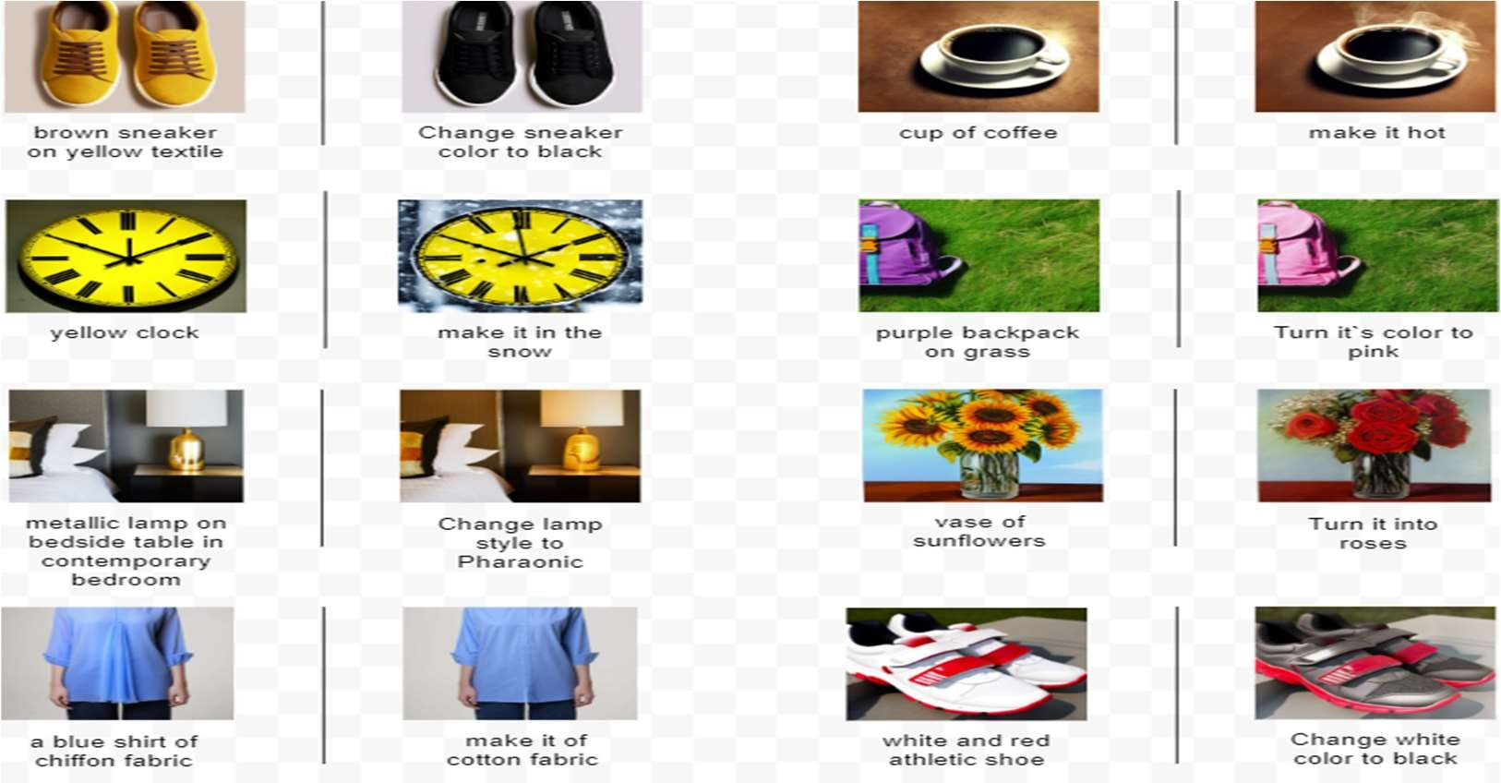




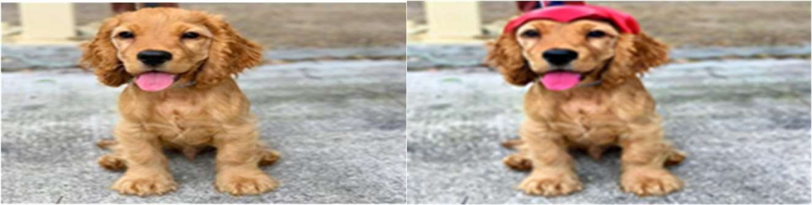


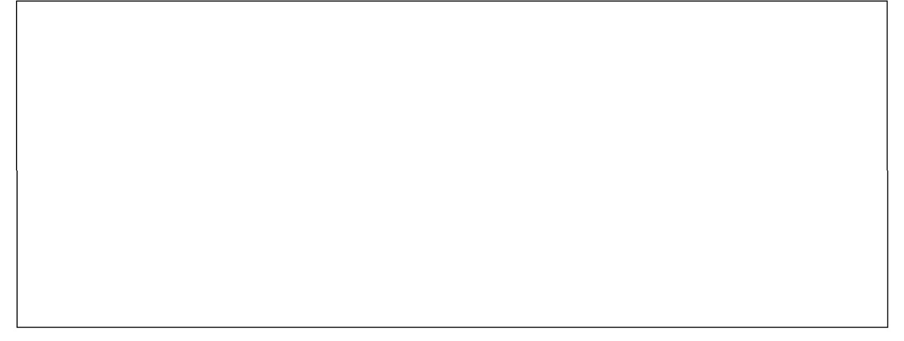
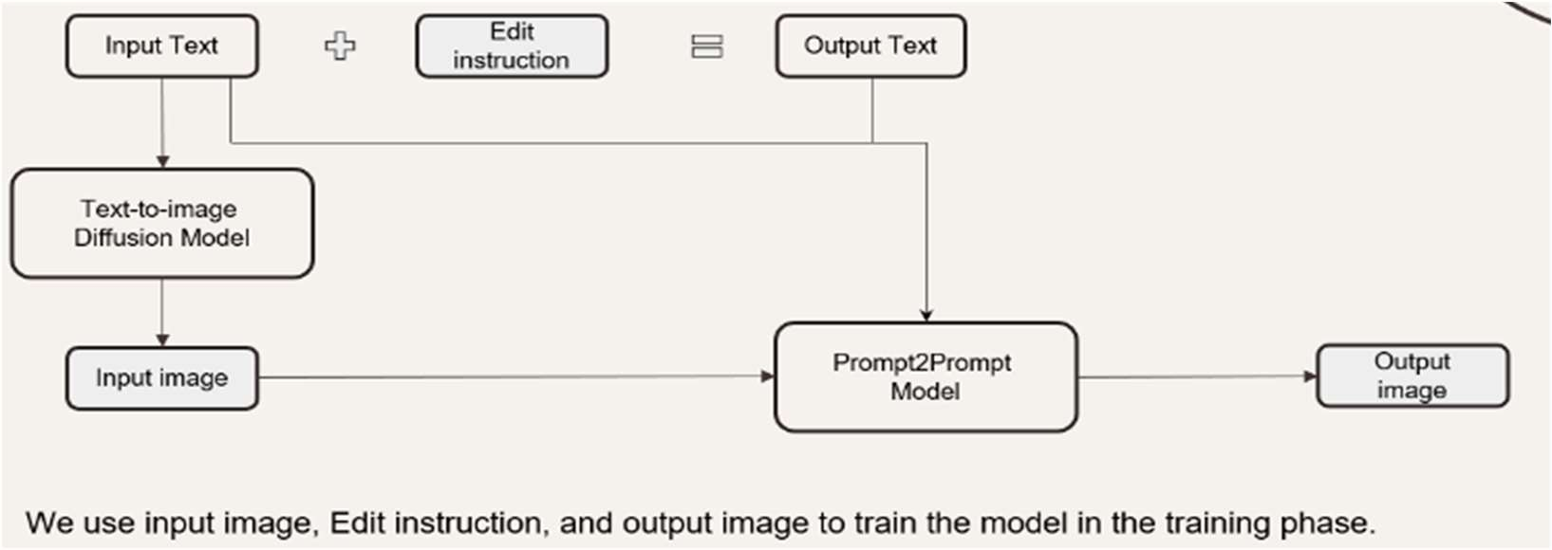

Text-Driven Image-To-Image Generation
Amir Moris, Mina Girgis, Verina Gad, Maria Tawfek, Carolina George
Supervised by: Prof. Dr. Abdelbadee Salem, Dr. Hanan Hindy, AL. Ghada El Nahas and AL. Yomna Ahmed
Computer Science Department – Faculty of Computer and Information Science - Ain Shams University
Abstract
This project aims to create a model capable of modifying images based on textual input. Users can upload an image and provide text-based instructions for desired changes. The system interprets these instructions and updates the image accordingly, ensuring high visual quality is preserved.
Figure 2: shows a sample of our own generated dataset.
Introduction
This project focuses on the product domain to enhance accuracy and quality in generating images based on text input. By developing a specialized system for product-based Image-to-Image generation, we address the lack of domain specificity and the absence of tailored datasets. Our approach aims to automate the image generation process, reducing manual effort and ensuring high-quality, contextually relevant outputs for e-commerce, marketing, and inventory management.
Results
We have several experiments:
First, we tested the Dreambooth model, but it required multiple input images and substantial resources, leading us to explore other models with Colab and Kaggle's resources.
In the second trial, we utilized the SINE model for single image editing, which faced challenges due to resource limitations, prompting a shift to the InstructPix2Pix model.
The third trial involved generating a product-based textual dataset using a hardcoded text synthesizer instead of a large language model to reduce costs.
Despite efforts to minimize parameters and partition the dataset, the InstructPix2Pix model's training still required more resources than available on Kaggle.
Consequently, in the fifth trial, we tested various platforms and settled on Kaggle for deployment while awaiting GPU access from the Supercomputing Facility at Bibliotheca Alexandrina.
Figure 3 illustrates a representative instance of the model output.
Methods
In our application, following InstructPix2Pix [1], instruction-based
image editing is approached as a supervised learning challenge. The model was pretrained on synthetic images (AI-generated images), the
model demonstrates the ability to effectively edit real images. This method utilizes a conditional diffusion model pretrained for editing images based on textual instructions. Inspired by Stable Diffusion, a comprehensive text-to-image model, this approach leverages latent diffusion. This technique enhances diffusion models by operating within the latent space of a pretrained variational autoencoder equipped with both encoder and decoder components, thereby optimizing efficiency and image quality. Additionally, we created a domain-specific dataset addressing a need in the Image-To-Image translation domain.
Our framework consists of 3 layers: Presentation Layer, Logic Layer, Data Layer.
Dataset Generation
Our project focuses on creating a domain-specific dataset for products to address the scarcity in the Text-driven Image-To-Image field. The dataset generation involves two main processes: textual data generation and image data generation. Textual data is gathered by scraping product descriptions from Unsplash.com and applying various editing instructions, while images are created using a text-to- image diffusion model and P2P for input and output images.
Figure 1 shows the complete dataset generation pipeline.
Input image
Edit instruction: add a superhero cape
Figure 3: Example on InstructPix2Pix2
Conclusion
We aimed to develop a system for text-driven image-to-image generation, using advanced deep learning models to automate image updates based on text inputs. We created a user-friendly interface hosted on Hugging Face and utilized a fine-tuned text-to-image diffusion model to ensure high visual quality. A significant effort was put into generating a domain-specific dataset using a hardcoded text synthesizer, thus, addressing a significant challenge that arises in Image-To-Image models.
References
T. Brooks, A. Holynski, and A. A. Efros "InstructPix2Pix: Learning to Follow Image Editing Instructions" in University of California, Berkeley, 2022.
Z. Zhang, L. Han, A. Ghosh, D. Metaxas, and J. Ren "SINE: SINgle Image Editing with Text- to-Image Diffusion Models" in Rutgers University, Snap Inc, 2022.
N. Ruiz, Y. Li, V. Jampani, Y. Pritch, M. Rubinstein, K. Aberman, “DreamBooth: Fine Tuning Text-to-Image Diffusion Models for Subject-Driven Generation”, in Boston University, 2023.
Figure 1: Dataset Generation
Figure 2 shows a sample of our own generated dataset.

